Slide 1
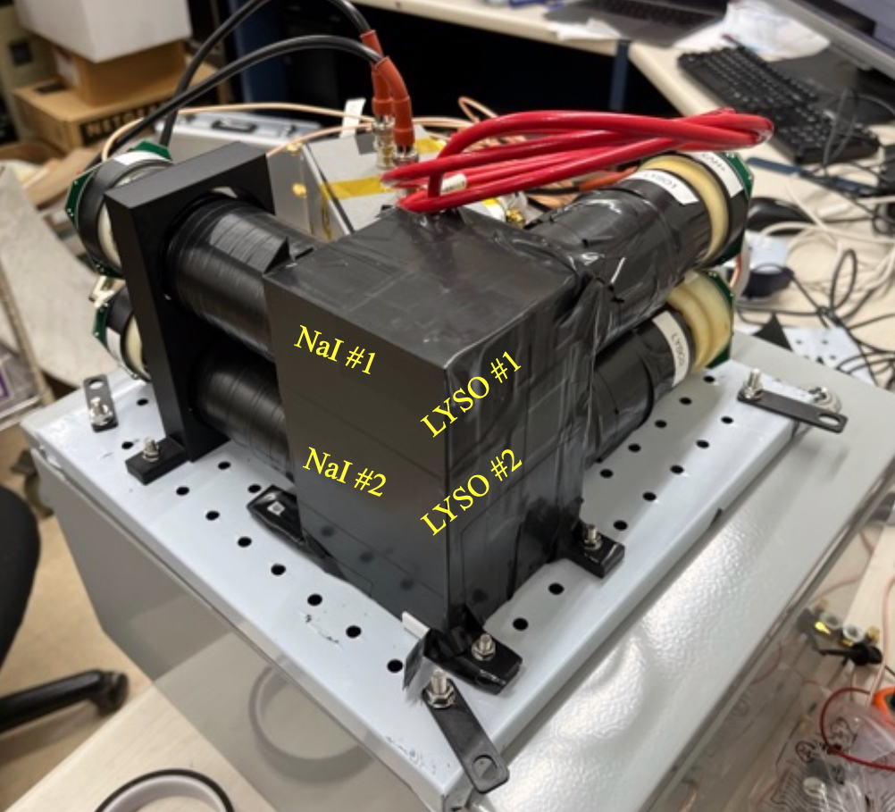
4 channel PMT detector
Sent to UC Davis to take data from their Cyclotron
Calibration data taken before it was sent out

Slide 2
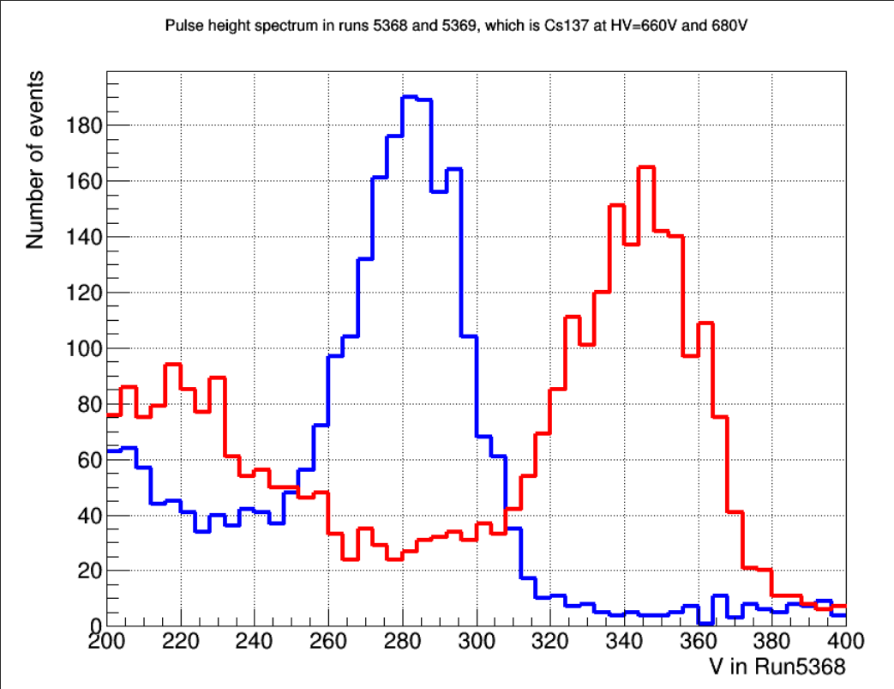
All data from channel 1 for now
Example plot using Cs137
Data for pulse height and pulse area to characterise gain
Peak height and area drift with high voltage

Slide 3
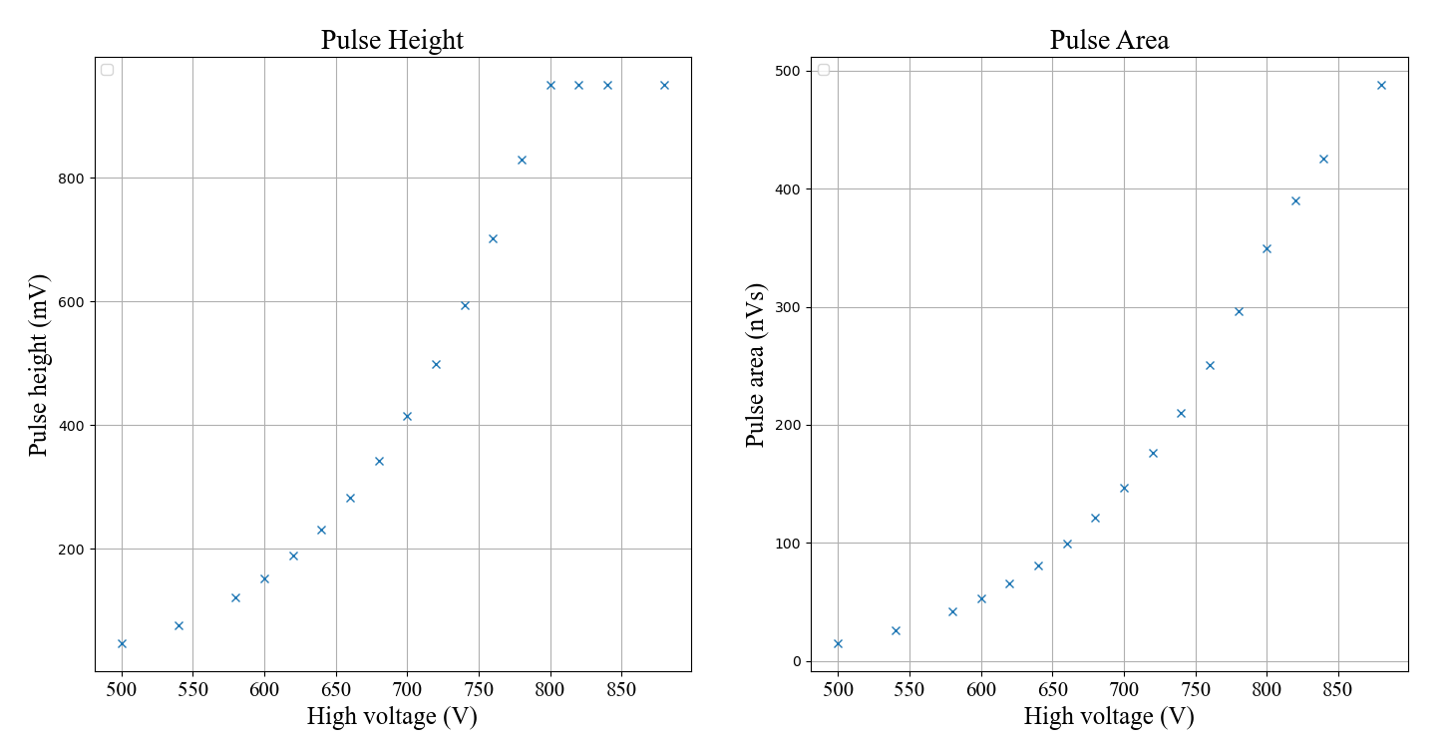
Calibration data taken with Cs137 (1 peak) and Ba133 (5 peaks) and no source (single SPE) – below is for Cs137
Saturates the detector at pulse height of about 950mV

Slide 4
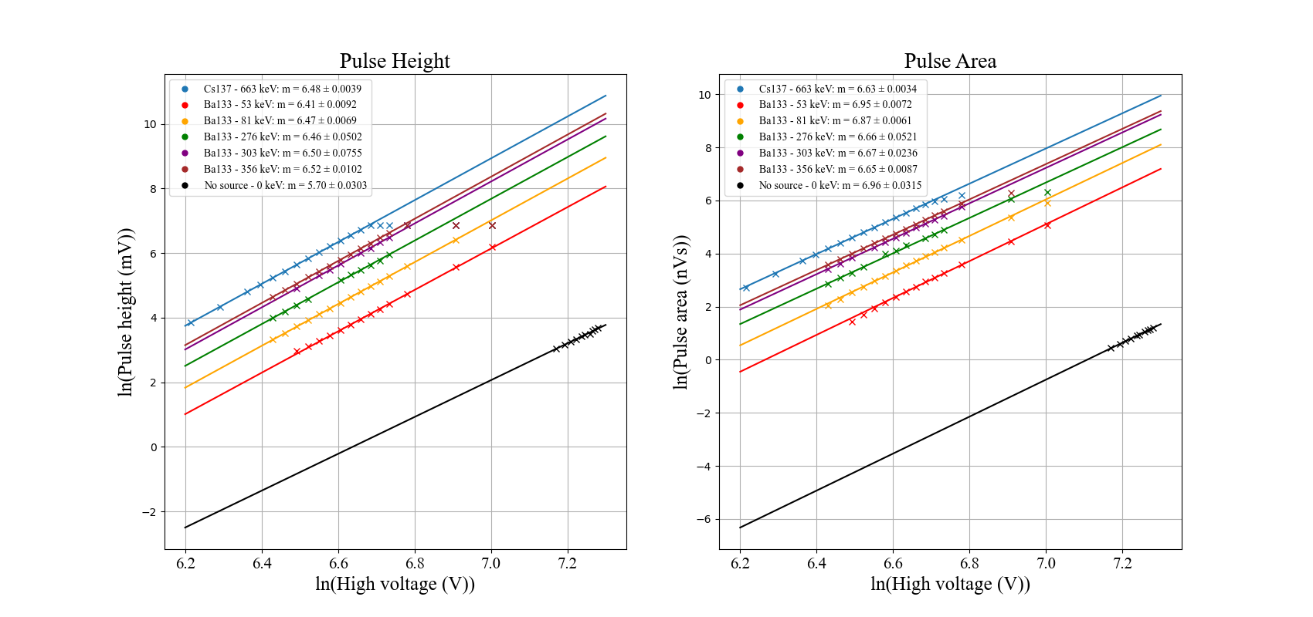
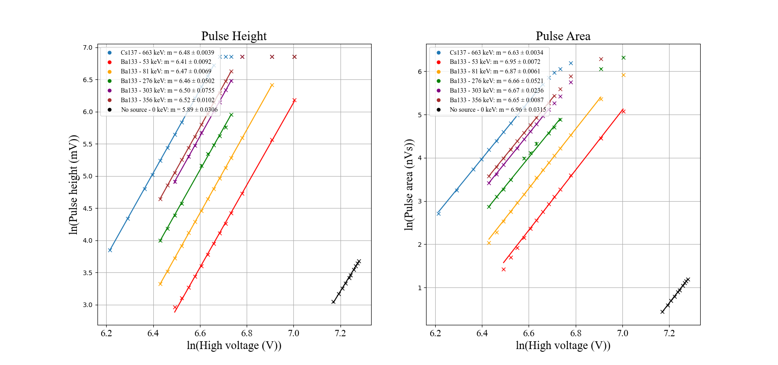
Fitting gain (μ) as a function of high voltage (V):
μ = AV^{b}
Ln(μ) = bln(V) + ln(A)

Slide 5
Pulse area slightly curves down at low signal sizes – not seen in pulse height
Potentially affects the single SPE – same sort of range
Notes:
Hypothesized that the pulse finding algorithm may be dropping some of the pulse area for samples below threshold. Find ratio of lines to find number of SPEs emitted.

Slide 6
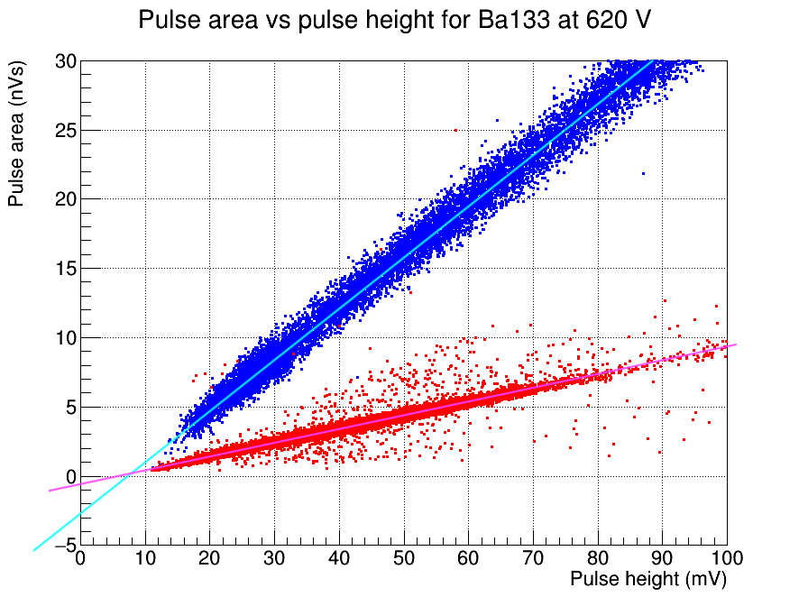
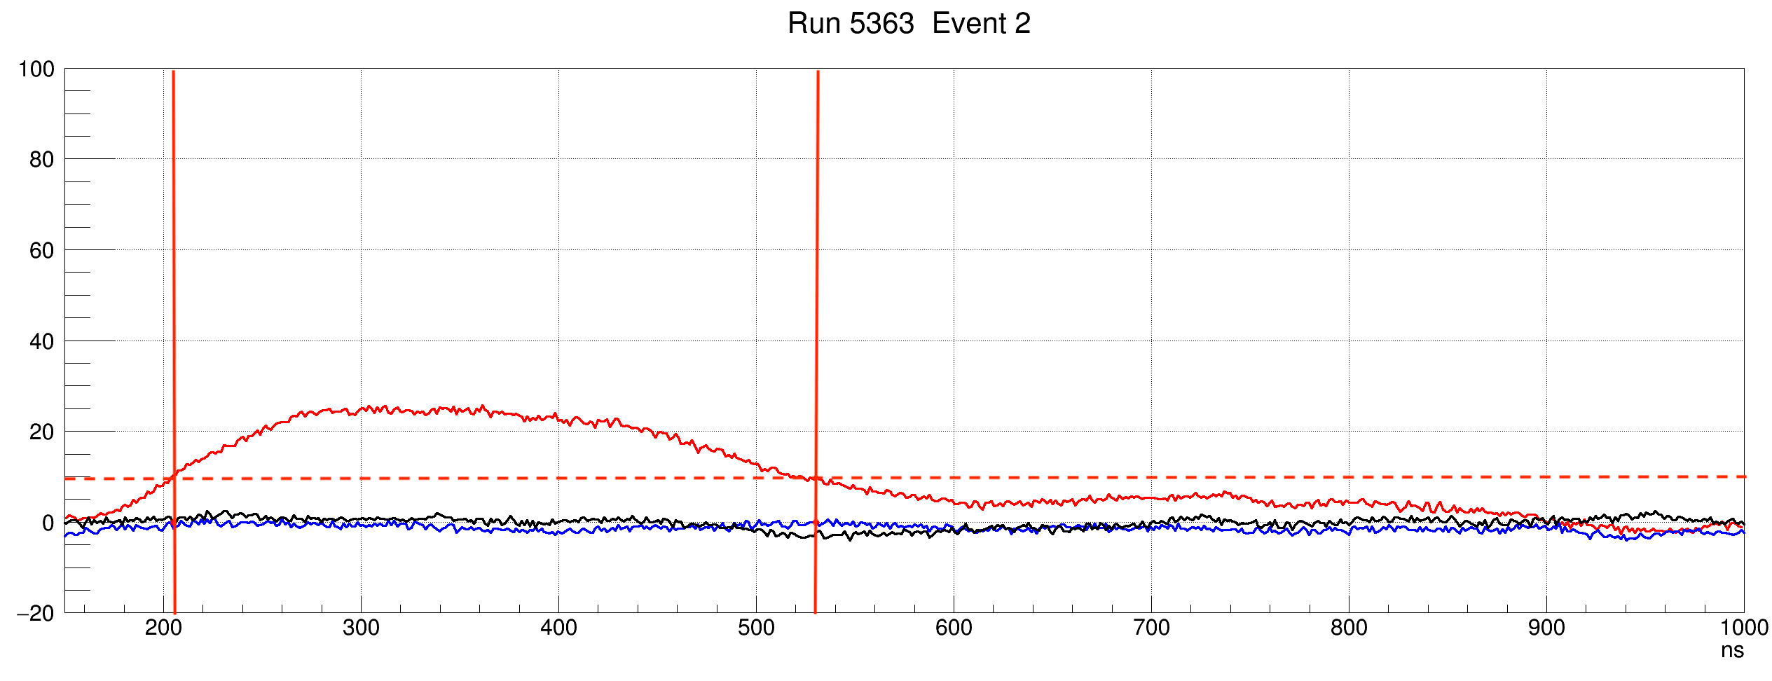
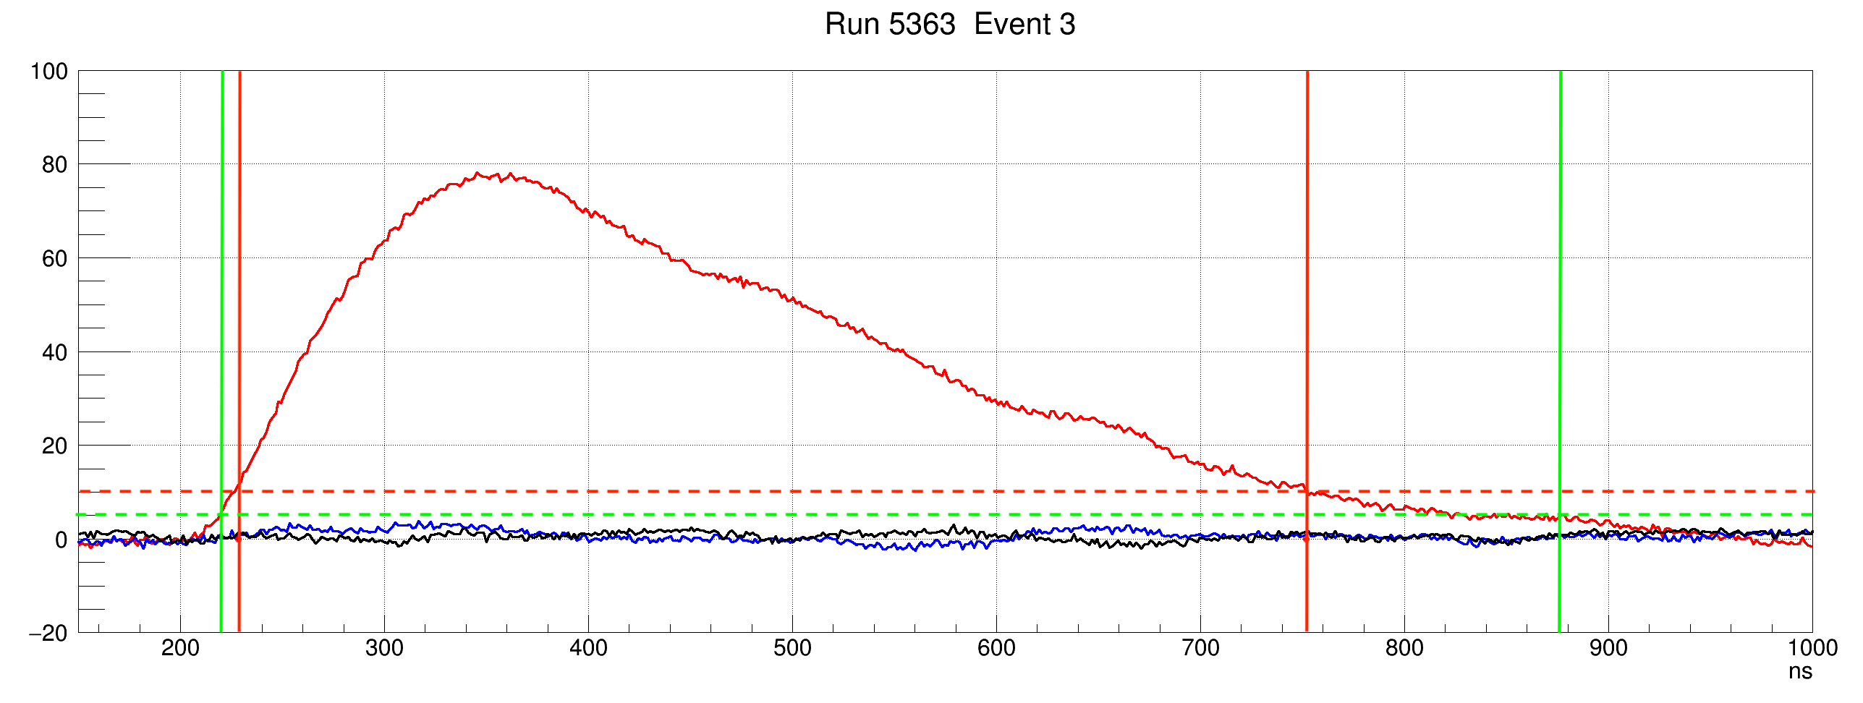
Low end effects based on the way pulse area was being calculated
Crude correction to low end saturation effects for pulse area
Add 0.7 nVs to SPE
Add 2.7 nVs to CH1 NaI

Slide 7
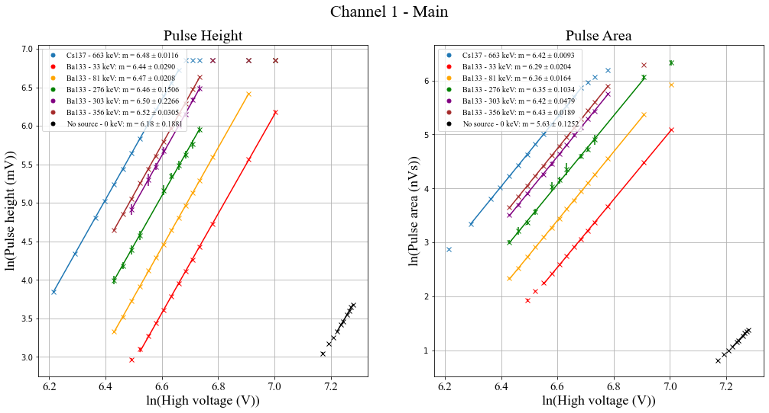
Seems to fix the problem
Points excluded on high and low end because of saturation effects based on residuals plot
SPE fitting somewhat arbitrary

Slide 8
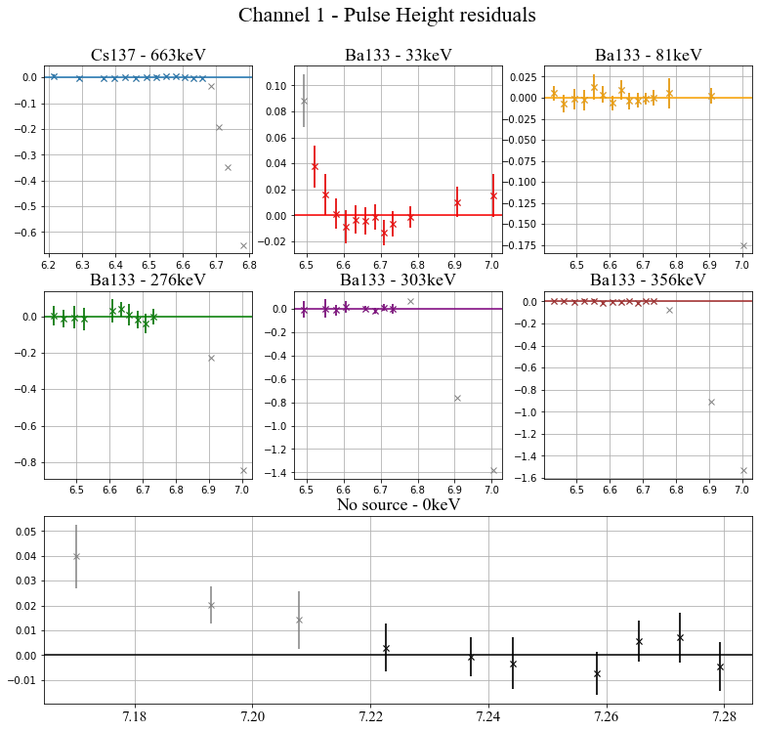
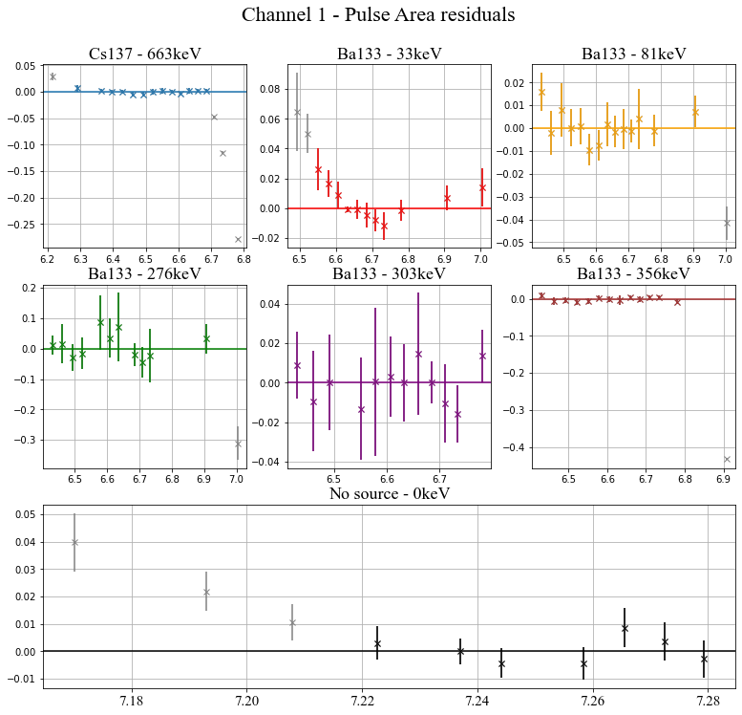

Slide 9
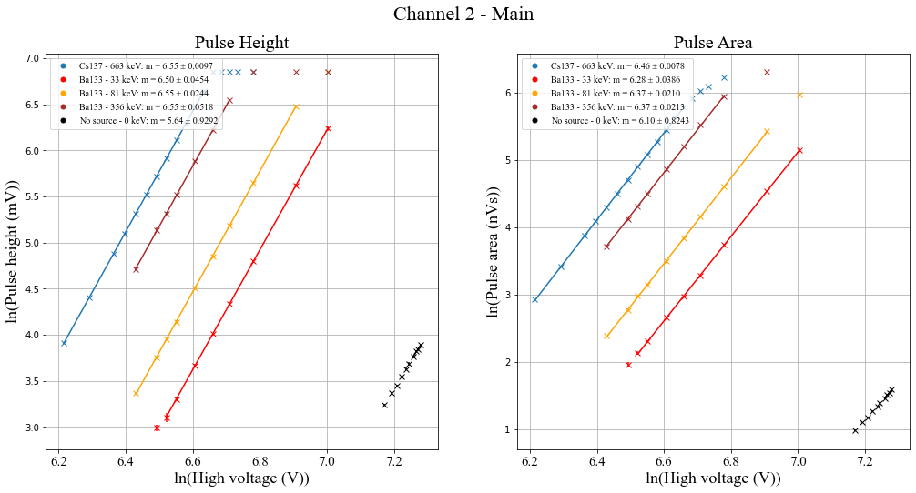
Check with data from channel 2 – didn’t take all the points

Slide 10
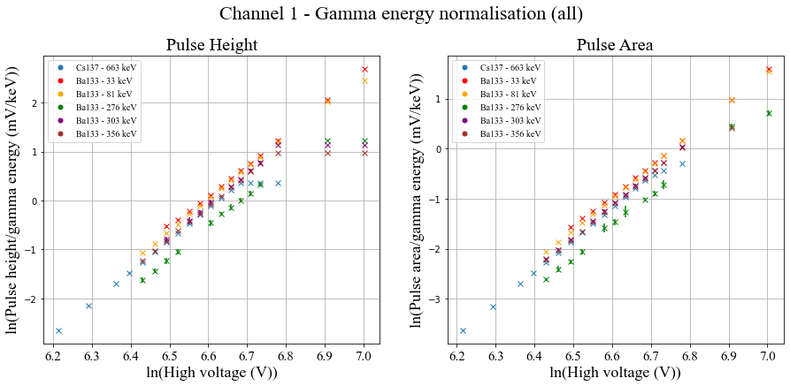
Collapsed all the lines onto one by scaling with gamma energy
Ba-133 doesn’t seem to fit – makes sense since it was the hardest to extract data from initially
Put it to the side now and work from the rest

Slide 11
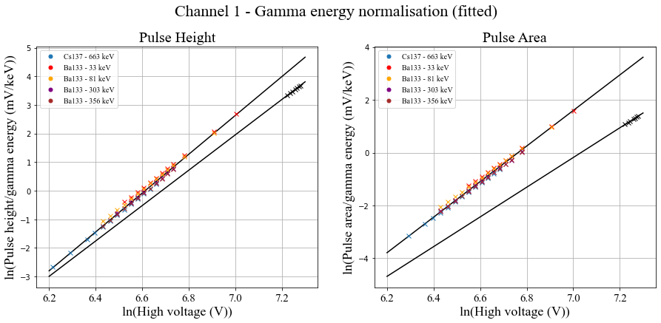
Very easy to see disparity in gradients now – bias effects
Sources :
gradient = 6.79 ± 0.0078
intercept = -44.9 ± 0.052
SPE :
gradient = 6.18 ± 0.19
intercept = -41.3 ± 1.4
Sources :
gradient = 6.73 ± 0.0061
intercept = -45.5 ± 0.040
SPE :
gradient = 5.63 ± 0.13
intercept = -39.6 ± 0.91

Slide 12
Take the last SPE point to find the number of SPE emitted per keV – last point is least affected from bias effects:
Pulse Height : 2.35 ± 0.18 SPE per keV
Pulse Area : 8.11 ± 0.49 SPE per keV
Discrepancy due to NaI being a slow detector – timescale of scintillation is relatively long so pulses arrive at slightly different times

Slide 13
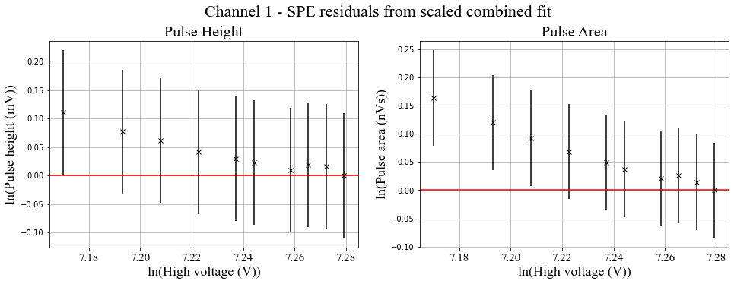
Scaling the collapsed line with the number of SPE per keV and plotting the residuals – last point fixed by design
Roughly curves into last point – we were justified in using the last point as a ‘best measurement’
Large errors from: measurement error, fitting errors, SPE per keV error

Slide 14
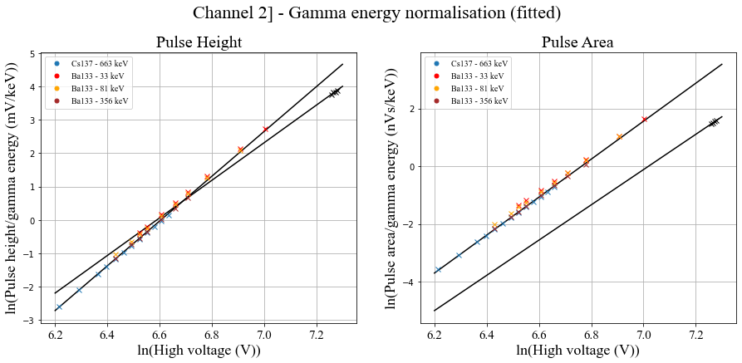
Doing the same thing for Channel 2
Sources :
gradient = 6.71 ± 0.0076
intercept = -44.3 ± 0.049
SPE :
gradient = 5.63 ± 0.93
intercept = -37.1 ± 6.8
Sources :
gradient = 6.57 ± 0.0060
intercept = -44.5 ± 0.040
SPE :
gradient = 6.10 ± 0.82
intercept = -42.9 ± 6.00

Slide 15
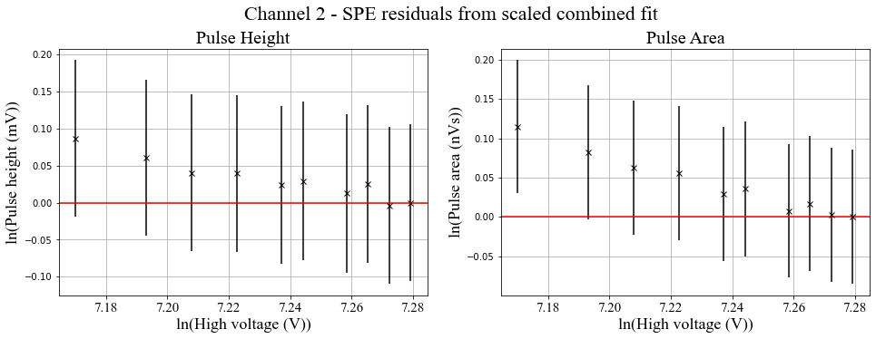
Again we use the last point as out marker for scaling.
Pulse Height : 1.89 ± 0.14 SPE per keV
Pulse Area : 6.11 ± 0.37 SPE per keV

